Slide 1
New York City Taxi Trips Data Analysis
Presented by: Junhao Liao
IT 533 - Big Data Technologies
Final Project
05/09/2018

Slide 2
Context
Data Set Introduction
Data Diagram - Accidents
Top 10 Accident Area Analysis
Data Diagram - Fastest Routes
Range of the Data Set Analysis
Hot Area of New York Taxi Analysis

Slide 3
Data Set Introduction
The New York City Taxi playground, which provides records that describe details of each taxi trip.
Majorly includes routes files as well as an accident data file.
All files are .csv format.
The dataset is retrieved from the following link: https://www.kaggle.com/oscarleo/new-york-city-taxi-with-osrm.

Slide 4
Data Diagram - Accidents
AREA | ZIP CODE | LATITUDE | LONGITUDE
String | String | String | String
BRONX | 10457 | 40.8454106 | -73.8911253

Slide 5
Top 10 Accident Area (Hive)
Description: Using Hive to load data into a table and get top 10 Area names with its counted number.
Specific HQL line: tblproperties("skip.header.line.count"="1");

Slide 6
Top 10 Accident Area (Hive)

Slide 7
Data Diagram - Fastest Routes
id | starting_street | end_street | total_distance | total_travel_time | number_of_steps
String | String | String | Numeric | Numeric | Numeric
id0771704 | 6th Avenue | 10th Avenue | 1497.1 | 200.2 | 7
street_for_each_step | distance_per_step | travel_time_per_step | step_maneuvers | step_direction | step_location_list
String | String | String | String | String | String
6th Avenue|West 17th Street|9th Avenue|9th Avenue|West 15th Street|10th Avenue|10th Avenue | 188.7|825.1|96.4|58.6|267.5|60.7|0 | 32.4|103.7|12.7|10.7|34|6.7|0 | depart|turn|turn|continue|turn|turn|arrive | left|left|left|slight right|right|right|arrive | -73.996527,40.737786|-73.995446,40.739272|-74.003999,40.742883|-74.004554,40.742125|-74.004919,40.741681|-74.007705,40.742834|-74.007355,40.743311

Slide 8
Range of the Data Set Analysis
Description: Based on the routes data, I want to analyze a rectangle area that covers all trips.
Mapper Output:
Min Latitude | Max Latitude | Min Longitude | Max Longitude
40.34552 | 41.096999 | -74.500929 | -73.229497

Slide 9
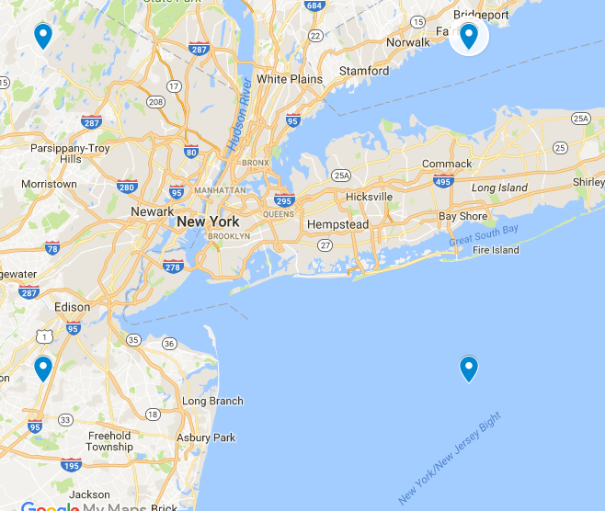
Range of the Data Set Analysis
On Google Map

Slide 10
Hot Area of New York Taxi Analysis
Right now I want to know the top areas that the most taxi trips passed by.
I divide the area that I got before to 10*10 blocks, as the table shows blow:
40.34552,
-73.229497
41.096999, -73.229497
40.34552,
-74.500929
41.096999, -74.500929

Slide 11
Hot Area of New York Taxi Analysis
The Top 5 Area from MapReduce:
Coordinations | Frequencies
40.7964074,40.8715553,-73.865213,-73.73806979999999 | 6848207
40.7964074,40.8715553,-73.9923562,-73.865213 | 1679779
40.7212595,40.7964074,-73.9923562,-73.865213 | 790983
40.7212595,40.7964074,-73.865213,-73.73806979999999 | 650099
40.8715553,40.946703199999995,-73.865213,-73.73806979999999 | 447708

Slide 12
Hot Area of New York Taxi Analysis
Let’s convert the coordination to the corresponding blocks:
-74.50093 | 40.34552 | 40.4206679 | 40.49582 | 40.571 | 40.64611 | 40.72126 | 40.79641 | 40.87156 | 40.9467 | 41.02185 | 41.097
-74.37379
-74.24664
-74.1195
-73.99236
-73.86521 |  |  |  |  |  |  | 3 | 2
-73.73807 |  |  |  |  |  |  | 4 | 1 | 5
-73.61093
-73.48378
-73.35664
-73.2295

Slide 13
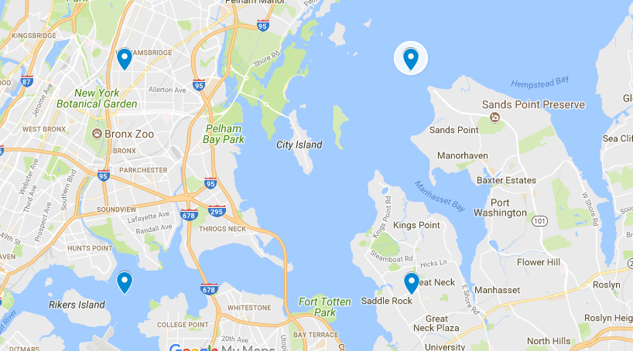
Hot Area of New York Taxi Analysis
On Google Map:
Conclusion:
The busiest part in New York is located in this area.
Carefully with traffic jam.
Iterative processes could locate the area smaller and smaller.

Slide 14
Thanks for your listening!

Slide 15
Reference
Oscarleo (2017). New York City Taxi with OSRM. Retrieved from https://www.kaggle.com/oscarleo/new-york-city-taxi-with-osrm

